Slide 1
Text From GCN: “DeepWalk (Perozzi et al., 2014) learns embeddings via the prediction of the local neighborhood of nodes, sampled from random walks on the graph. LINE (Tang et al., 2015) and node2vec (Grover & Leskovec, 2016) extend DeepWalk with more sophisticated random walk or breadth-first search schemes. For all these methods, however, a multistep pipeline including random walk generation and semi-supervised training is required where each step has to be optimized separately. ”
GCN
citation context
node2vec
GraphSAGE
word2vec
…
Notes:
GraphSAGE cites DeepWalk

Slide 2
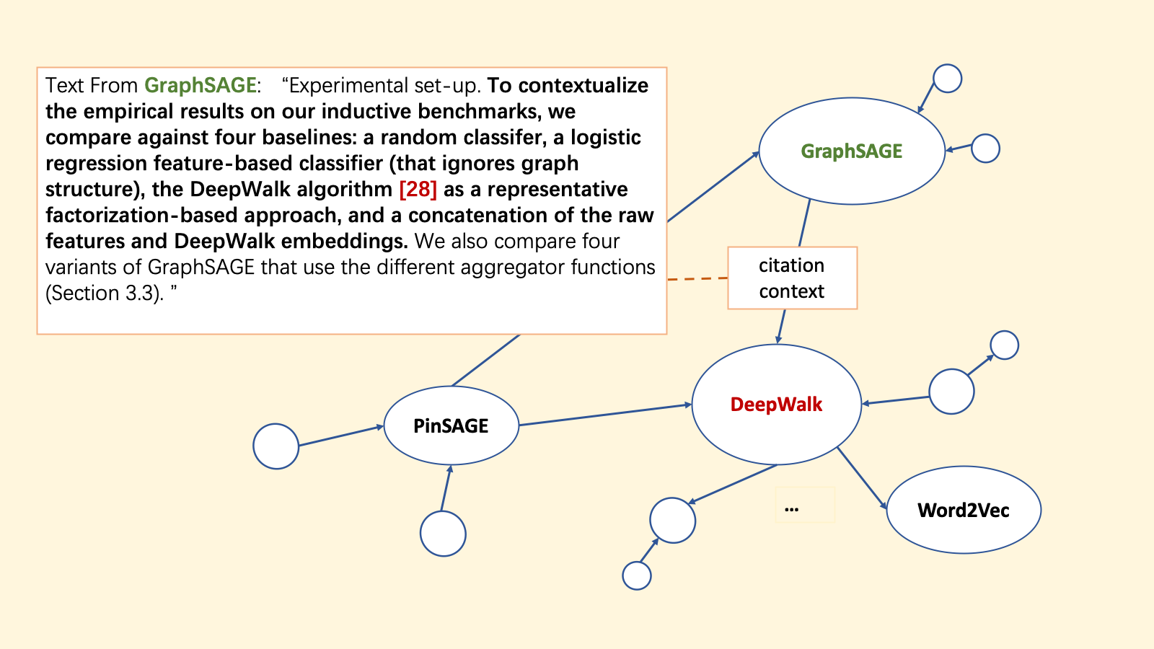
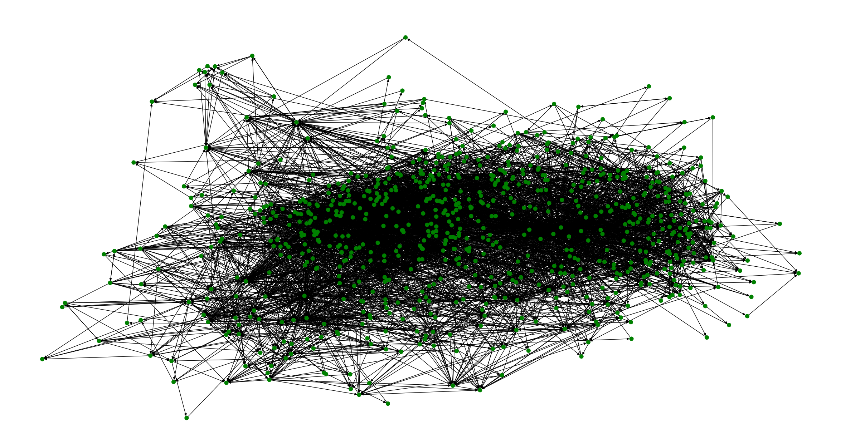

Slide 3
Text From GraphSAGE: “Experimental set-up. To contextualize the empirical results on our inductive benchmarks, we compare against four baselines: a random classifer, a logistic regression feature-based classifier (that ignores graph structure), the DeepWalk algorithm [28] as a representative factorization-based approach, and a concatenation of the raw features and DeepWalk embeddings. We also compare four variants of GraphSAGE that use the different aggregator functions (Section 3.3). ”
GraphSAGE
citation context
DeepWalk
PinSAGE
Word2Vec
…
Notes:
GraphSAGE cites DeepWalk

Slide 4
Text From GraphSAGE: “We also compare four variants of GraphSAGE that use the different aggregator functions (Section 3.3). Since, the "convolutional" variant of GraphSAGE is an extended, inductive version of Kipf et al's semi-supervised GCN [17] , we term this variant GraphSAGE-GCN. We test unsupervised variants of GraphSAGE trained according to the loss in Equation (1), as well as supervised variants that are trained directly on classification cross-entropy loss. ”
GraphSAGE
citation context
GCN
GCMC
Word2Vec
…
Notes:
GraphSAGE cites DeepWalk

Slide 5
citation context
…
Notes:
GraphSAGE cites DeepWalk

Slide 6
4755450 3144218 Inductive Representation Learning on Large Graphs ===CITES=== Semi-Supervised Classification with Graph Convolutional Networks [17]::We also compare four variants of GraphSAGE that use the different aggregator functions (Section 3.3). Since, the "convolutional" variant of GraphSAGE is an extended, inductive version of Kipf et al's semi-supervised GCN [17] , we term this variant GraphSAGE-GCN. We test unsupervised variants of GraphSAGE trained according to the loss in Equation (1), as well as supervised variants that are trained directly on classification cross-entropy loss.
46949657 26988 Graph Convolutional Neural Networks for Web-Scale Recommender Systems ===CITES=== node2vec: Scalable Feature Learning for Networks [17]::Following on this work, a number of authors proposed improvements, extensions, and approximations of these spectral convolutions [6, 10, 11, 13, 18, 21, 24, 29, 31] , leading to new state-of-the-art results on benchmarks such as node classification, link prediction, as well as recommender system tasks (e.g., the MovieLens benchmark [24] ). These approaches have consistently outperformed techniques based upon matrix factorization or random walks (e.g., node2vec [17] and DeepWalk [26] ), and their success has led to a surge of interest in applying GCN-based methods to applications ranging from recommender systems [24] to drug design [20, 31] . Hamilton et al. (2017b) [19] and [6] provide comprehensive surveys of recent advancements.
46949657 3144218 Graph Convolutional Neural Networks for Web-Scale Recommender Systems ===CITES=== Semi-Supervised Classification with Graph Convolutional Networks [21]::We then concatenate the aggregated neighborhood vector n u with u's current representation h u and transform the concatenated vector through another dense neural network layer (Line 2). Empirically we observe significant performance gains when using concatenation operation instead of the average operation as in [21] . Additionally, the normalization in Line 3 makes training more stable, and it is more efficient to perform approximate nearest neighbor search for normalized embeddings (Section 3.5).
4755450 3051291 Inductive Representation Learning on Large Graphs ===CITES=== DeepWalk: Online Learning of Social Representations [28]::In all these experiments, we perform predictions on nodes that are not seen during training, and, in the case of the PPI dataset, we test on entirely unseen graphs.Experimental set-up. To contextualize the empirical results on our inductive benchmarks, we compare against four baselines: a random classifer, a logistic regression feature-based classifier (that ignores graph structure), the DeepWalk algorithm [28] as a representative factorization-based approach, and a concatenation of the raw features and DeepWalk embeddings. We also compare four variants of GraphSAGE that use the different aggregator functions (Section 3.3).
Notes:
More examples

Slide 7
26988 3051291 node2vec: Scalable Feature Learning for Networks ===CITES=== DeepWalk: Online Learning of Social Representations [24,::We achieve this by developing a family of biased random walks, which efficiently explore diverse neighborhoods of a given node. The resulting algorithm is flexible, giving us control over the search space through tunable parameters, in contrast to rigid search procedures in prior work [24, 28] . Consequently, our method generalizes prior work and can model the full spectrum of equivalences observed in networks.
3332112 26988 Community Aware Random Walk for Network Embedding ===CITES=== node2vec: Scalable Feature Learning for Networks [24]::Some previous researches tried to embed community information on nodes' representation. For instance, Grover et al. in [24] only consider the community members that their distance to the source nodes is less than 2. However, in real-world networks which communities have thousands of members, Node2vec would not be able to consider information about the nodes that their distance is more than two from the source of random walk because Node2vec creates second order random walks.
46949657 3144218 Graph Convolutional Neural Networks for Web-Scale Recommender Systems ===CITES=== Semi-Supervised Classification with Graph Convolutional Networks [21]::We then concatenate the aggregated neighborhood vector n u with u's current representation h u and transform the concatenated vector through another dense neural network layer (Line 2). Empirically we observe significant performance gains when using concatenation operation instead of the average operation as in [21] . Additionally, the normalization in Line 3 makes training more stable, and it is more efficient to perform approximate nearest neighbor search for normalized embeddings (Section 3.5).
4755450 3051291 Inductive Representation Learning on Large Graphs ===CITES=== DeepWalk: Online Learning of Social Representations [28]::We use two evolving document graphs based on citation data and Reddit post data (predicting paper and post categories, respectively), and a multigraph generalization experiment based on a dataset of protein-protein interactions (predicting protein functions). Using these benchmarks, we show that our approach is able to effectively generate representations for unseen nodes and outperform relevant baselines by a significant margin: across domains, our supervised approach improves classification F1-scores by an average of 51% compared to using node features alone and GraphSAGE consistently outperforms a strong, transductive baseline [28] , despite this baseline taking ∼100× longer to run on unseen nodes. We also show that the new aggregator architectures we propose provide significant gains (7.4% on average) compared to an aggregator inspired by graph convolutional networks [17] .
Notes:
More examples

